Slide 1
Data Spark: Illuminating Insights for Global Electronics
Presented by Aravindh

Slide 2
Goal: To provide actionable recommendations that can enhance customer satisfaction, optimize operations, and drive overall business growth.

Slide 3
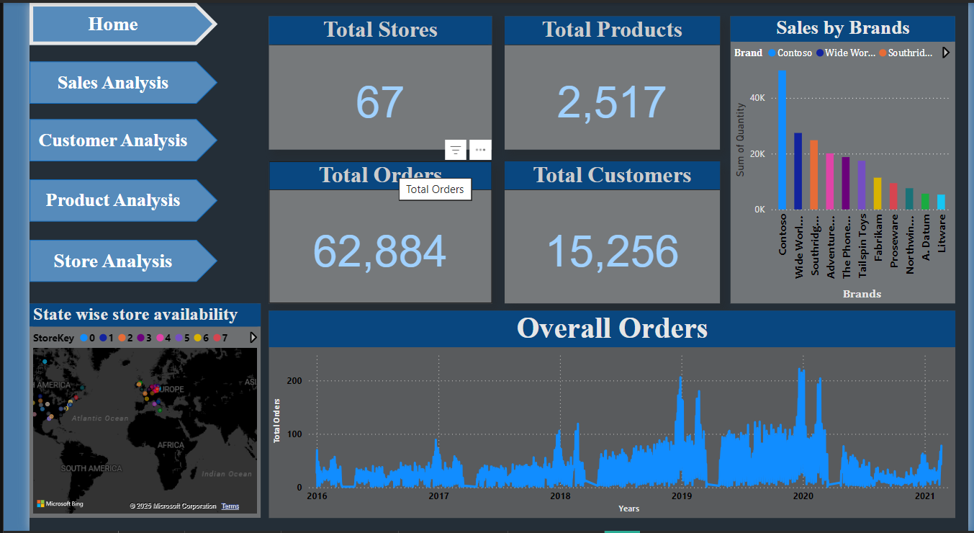
Dashboard : Home

Slide 4
Home page description
In home page, we are having summarized data of Global Electronics,
Having Total Stores of 67 Stores (includes online).
Having Total Products of 2517 Products.
Having Total Customers of 15256 Customers.
Having Total Orders of 65884 Orders.
Sales details by brand was explained in Ribbon Chart.
Overall Orders from 1st January 2016 to 20th February 2021.
Graphical Representation of Store availability in State vice.

Slide 5
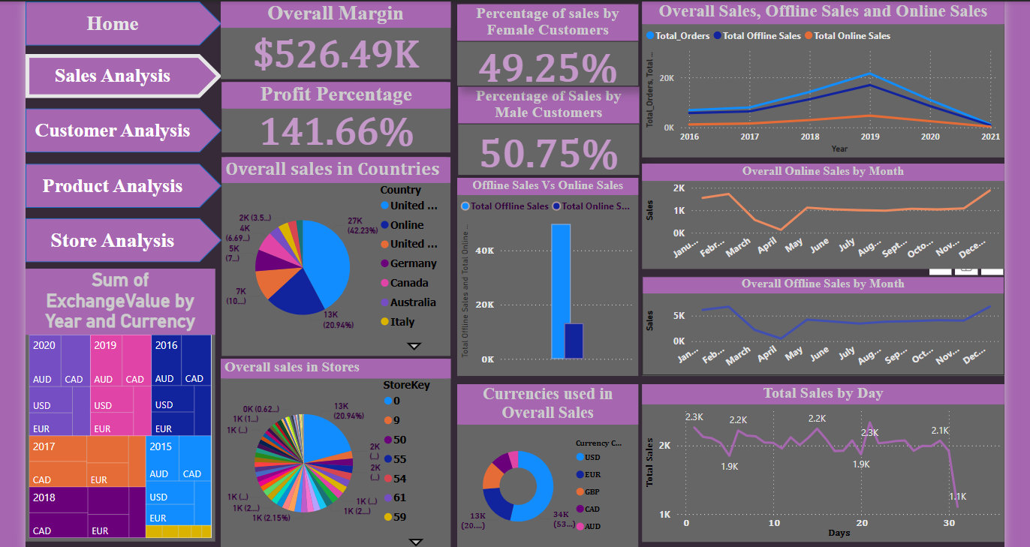
Sales Analysis Dashboard

Slide 6
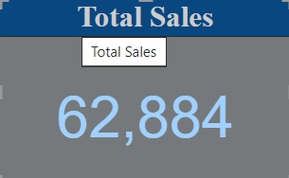
Sales Analysis Description
→ Card describes overall sales done by Global
Electronics
Sales percentage by Gender:
Male – 50.75%
Female – 49.25 %
In Global Electronics sales was done almost equal by genders. So, there is no need to concentrate on selling products by gender specific.

Slide 7
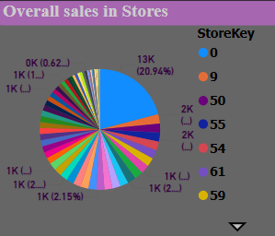
Sales by Stores:
By comparing overall sales in stores, Store at Northwest Territories in Canada holds the highest sales of 1577 sales recorded in the store.
Followed by Store at Kanas in United States holds the second position where 1518 sales recorded in the store.
Store at Corse in France recorded with lowest sales of 184 sales recorded in the store.
Overall Sales by Stores was explained in the Pie Chart

Slide 8
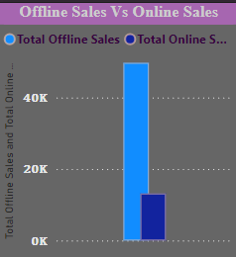
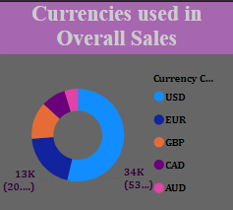
Online Sales Vs Offline Sales:
Overall, 49719 offline sales recorded.
And 13165 online sales recorded.
Sales By Currency:
By using Currency USD, 33767 sales done in Global Electronics which holds around 53 percentage of overall sales.
By using Currency AUD, 2941 sales recorded which was the lowest currency used during the sales.

Slide 9
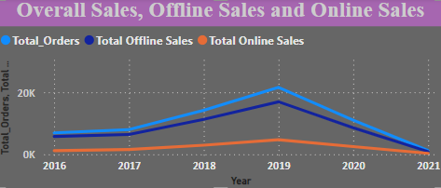
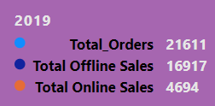
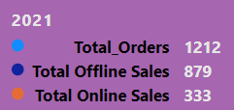
Sales Over the period between 2016 and 2021:
By Analyzing the sales over the period,
From 2016 to 2017 -> Almost same sales was happened.
From 2017 to 208 -> Gradual increase in the sales had been recorded.
From 2018 to 2019 -> Gradual increase and attains the maximum sales and approximately 21611 total sales was recorded.
From 2019 to 2021 -> Sales drops to the lowest and approximately 1212 sales was recorded.
Sales over the period
Maximum sales
Minimum sales

Slide 10
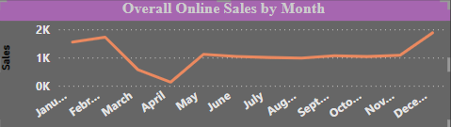
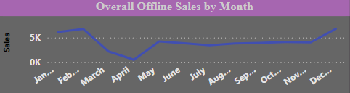
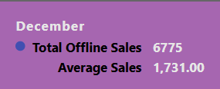
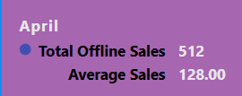
Seasonality in Sales:
Online Sales Offline Sales
When we compare both the online and the offline sales, the sales was peaked during the months December, January and February.
During the Month of April, the sales was recorded to its lowest sales.
Average Sales:
And also, during the month of December, an average sales was 1731 approximately.
During the month of April, an average sales was 128 only.

Slide 11
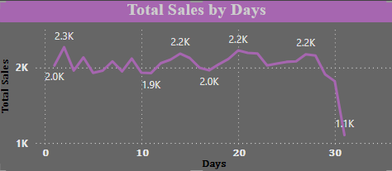
In every month end, sales was attaining to its minimum level.
Overall Margin:
By selling each and every product once, Global Electronics is getting margin of $526.49K which means profit percentage hits 141.66 percentage.

Slide 12
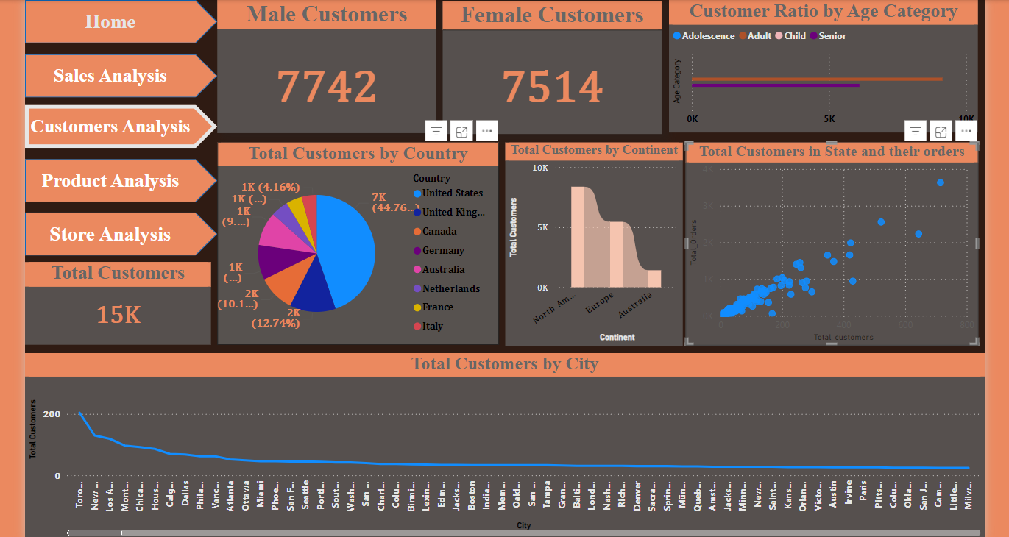
Customer Analysis Dashboard

Slide 13
Customer Details Description
Having Total Customers of 15256. Out of 15k customers, 7742 are Male and 7514 are Female Customers.
By Analysing customers history, Global Electronics having 9143 Adult Customers and 6113 Senior Customers.
Nearly 45 percentage of customers are in United States which holds the highest customers percentage and Italy holds least customers of 4.16 percentage
When we compare the customers in the Continents North America, Europe and Australia, Global Electronics have 5:4:1 ratio of customers respectively.

Slide 14
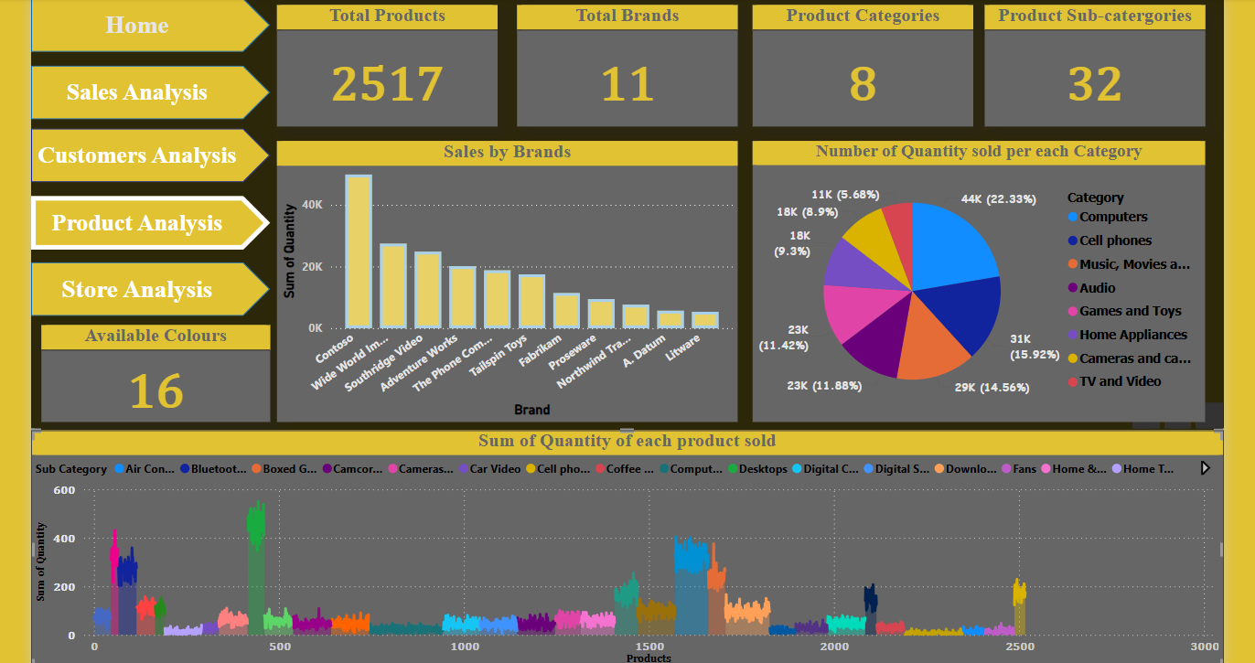
Product Analysis Dashboard

Slide 15
Product Analysis Description
Global Electronics have around 2517 products.
Totally Global Electronics having 11 Brands.
Overall product was categorized by 8 types/category which was further classified into 32 subcategories.
Having 16 different colors.

Slide 16

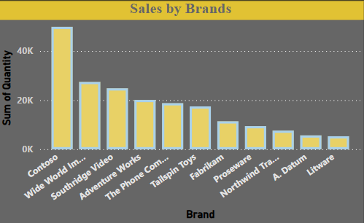

When we comparing sales by Brands, Contoso was the most sold brand and around 50k quantity of product was sold.
At the same time, Litware was the brand which products are sold at lowest. And around 5k quantity of product was sold.
Sales by Brands

Slide 17
Product Category:
By Analyzing product sales by category, products under Computer category sold maximum and about 22 percentage of sales was recorded.
Followed by Cell Phone Category products.
TV and Video category products are sold least and about 5.6 percentage of sales was recorded.
Product Profit Details:
When we compare the Margin of all products, the products “Fabrikam Refrigerator 24.7CuFt X9800” and “Litware Refrigerator 24.7CuFt X980” are having highest margin about $2139. On the other hand, SV USB Data Cable E600 having the least margin of $0.47 (but this also gives 100% profit since it has the making price of $0.48).

Slide 18
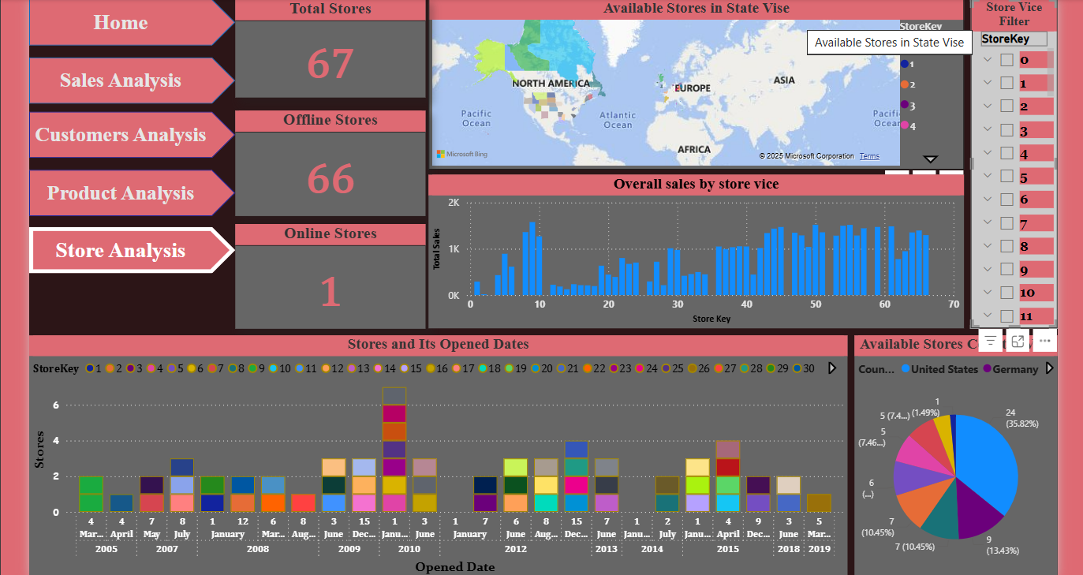
Store Analysis Dashboard

Slide 19
Store Analysis Description
Global Electronics having globally 67 stores in which 66 was offline stores and 1 was online store.
When comparing stores in Country vice, United States having the highest number of stores. i.e., Unites States alone having 24 Stores.
Italy having 3 stores which holds the least number of stores.
Store at Northwest Territories (Store Key 9) in Canada records the highest number of sales. Totally 1577 sales was done in it.
Store at Northern Territory (Store Key 2) in Australia records second least number of sales. Totally 18 sales was recorded.

Slide 20
Stores in the below tabular column are found to be no sales were recorded.
Store | Country | State | Area | Opened date
3 | Australia | South Australia | 2000 | 01-07-2012
7 | Canada | New Brunswick | 1105 | 05-07-2007
11 | Canada | Yukon | 1210 | 06-03-2009
25 | Germany | Mecklenburg-Vorpommern | 1610 | 01-01-2010
35 | Netherlands | Zeeland | 1225 | 05-07-2007
46 | United States | Delaware | 1015 | 08-08-2012
52 | United States | Mississippi | 2000 | 06-03-2009
58 | United States | North Dakota | 1330 | 07-08-2007
60 | United States | Rhode Island | 1260 | 04-04-2005

Slide 21
Recommendation:
For Sales:
During the months from December, January and February it is suggested to launch new products for better sales and profit.
During the month of April, it is advised to bring some offers to get better sales.
Providing exchange offers for old products.
Providing month end sales like buy 2 get 1 offers.
Providing no cost EMI/EMI plans to get more sales.

Slide 22
Some of the stores are recorded with no sales, it brings heavy loss to Global Electronics. In such places, need to analyse the customer availability, get the feedbacks and understand the customer needs.
Improve the marketing strategies, and providing free instalments and free service for certain period to bring the customers back.
May be the location of the store was not near to Civilians area or we may not get the appropriate data.

Slide 23
For Customers:
By comparing Male and Female customers, almost equal in percentages. So there is no need to concentrate to get new customers in Gender Specific.
But when we comparing customers by age category, we are having 2:3 ratio of Seniors and Adult Customers. So need to get new Senior customers by providing offers for senior people like for every purchase of DVD player Global Electronics can offer free DVD with old shows / movies for Elder ones to remember their old memories.
To get new child customers, it is recommended to provide Gaming accessories, study materials like Laptops, Recorders, Projectors at affordable cost.

Slide 24
Bring a friend: By this offer for every referral we can give some points or provide offer to them, so that we can gain more customers and increase the sales ratio.
Providing coupons and rewards, so that customers can redeem it on their next purchase. By this we can bring the customer back to Global Electronics for purchase.
For Products:
Products from the brand, Contoso was the most liked and sold one. So it is recommended to make available of this brand in all stores and make good partnership with such brands.

Slide 25
Litware brand is the least selling one, so make better deal to such Brands and get more products with low cost from the Litware brand and sell it with affordable cost. So sales ratio may increase.
Products like TV and DVD are less purchased. Since advanced Televisions like Smart TV, Android TV are available in the Market. So Global Electronics supposed to bring the upgraded TV to their Stores for sales.

Slide 26
For Stores:
Make customers as Members by providing few schemes such as for customers who have the membership there will be a certain percent of off for all products, free delivery etc., to keep the existing customers and also it may bring new customers to stores.
For Online, the website should be user friendly to purchase products. So, people may interest to buy products on online too.
Instead of increasing the stores in nearest areas, it is recommended to have a centralized hub and selling the products by online with better offer. This will reduce the cost for maintaining multiple stores.

